Slide 1

Microprocessors and Assembly language Fall 2019
Hamed Farbeh
farbeh@aut.ac.ir
Department of Computer Engineering
Amirkabir University of Technology

Slide 2
Grading
Final Exam: 40%
Midterm Exam: 30%
Homework: 20%
Final Project: 10%
AND
Lab
Microprocessors and Assembly Language, Fall 2019, AUT, Tehran, Iran

Slide 3
Course Outline
Microprocessors and microcontrollers
How they work
AND
How to work with them
Microprocessors and Assembly Language, Fall 2019, AUT, Tehran, Iran

Slide 4
References
Main
Arm Assembly Language Programming and Architecture, Volume 1, 1st edition, Muhammad Ali Mazidi, Sarmad Naimi, and Sepehr Naimi, MicroDigitalEd, 2013
Complementary material
ARM Assembly Language: Fundamentals and Techniques, 2nd Ed., William Hohl, Christopher Hinds, CRC Press, 2014.
Modern Assembly Language Programming with the ARM Processor, Larry D. Pyeatt, Elsevier, 2016.
Embedded Systems:Introduction to ARM®CORTEX-M Microcontrollers, Vol. 1, 5th Ed., Jonathan W. Valvano, 2014.
Microprocessors and Assembly Language, Fall 2019, AUT, Tehran, Iran

Slide 5
Copyright Notice
Parts (text & figures) of this lecture are adopted from:
Computer Organization & Design, The Hardware/Software Interface, 3rd Edition, by D. Patterson and J. Hennessey, Morgan Kaufmann publishing, 2005.
“Computer Organization & Design” handouts, by Prof. Kumar, UIUC, Fall 2007.
“Computer Organization I” handouts, FSU, Fall 2007.
“Machine Structures” handouts, by Prof. D. Garcia, UCB, Spring 2010.
Arm Assembly Language Programming and Architecture, Volume 1, 1st edition, Muhammad Ali Mazidi, Sarmad Naimi, and Sepehr Naimi, MicroDigitalEd, 2013
“Computer Organization & Language” handouts, Dept. of CE, SUT, by Prof. H. Asadi, 2016.
Microprocessors and Assembly Language, Fall 2019, AUT, Tehran, Iran

Slide 6
Computer History
Mechanical Computers
Electro-Mechanical Computers
Electronic Computers
Microprocessors and Assembly Language, Fall 2019, AUT, Tehran, Iran

Slide 7
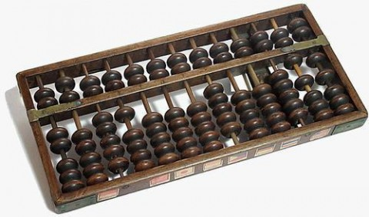
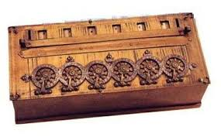
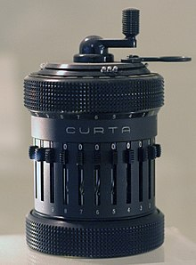
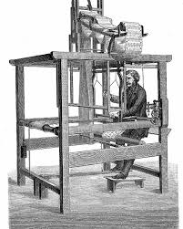
Computer History
Mechanical Computers
Abacus
Mechanical calculators
Pascal’s calculator (1652)
Curta (1930s)
Punched-card data processing (1725, 1800s, 1900s)
Microprocessors and Assembly Language, Fall 2019, AUT, Tehran, Iran

Slide 8
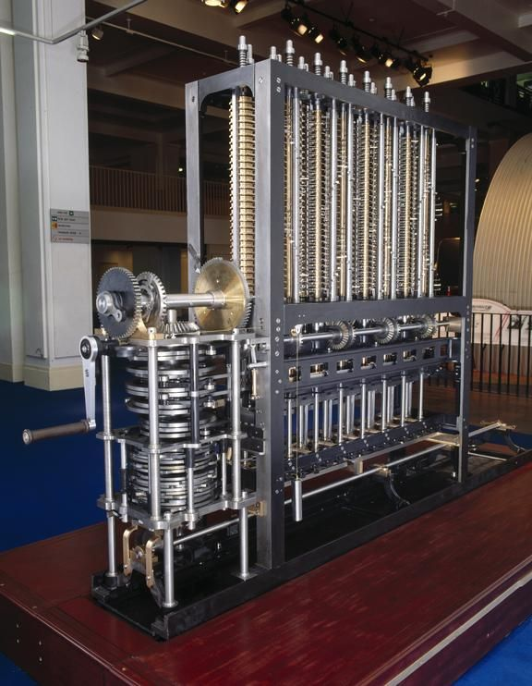
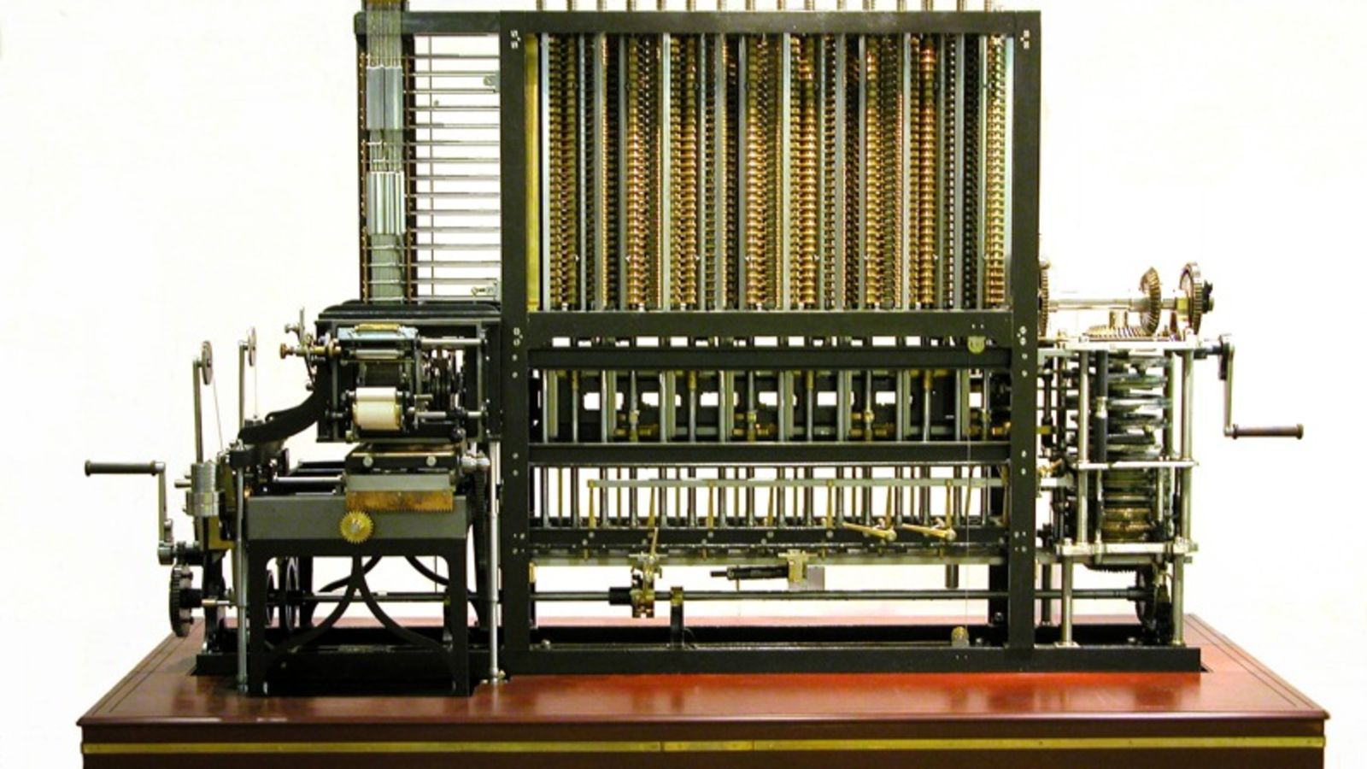
Computer History
Mechanical Computers
Difference engine: Charles Babbage (1791-1871)
First general-purpose computing device
Analytical engine
Microprocessors and Assembly Language, Fall 2019, AUT, Tehran, Iran

Slide 9
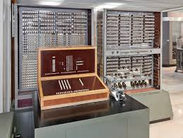
Computer History
Electro-Mechanical Computers
Switches, relays
Early 1900s
Zuse’s Z2, Z3, Z4 (world's first commercial digital computer, mechanical memory)
Microprocessors and Assembly Language, Fall 2019, AUT, Tehran, Iran

Slide 10
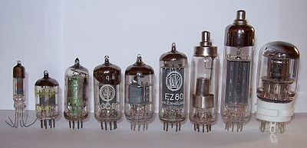
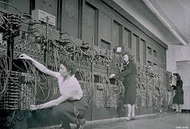
Computer History
Electronic Computers
1st generation
vacuum tubes (1945-1955)
ENIAC, 1946
Microprocessors and Assembly Language, Fall 2019, AUT, Tehran, Iran

Slide 11


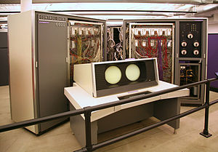
Computer History
Electronic Computers
2nd generation
BJT transistors (1955-1965)
CDC 6600 (1964-1969)
world's fastest computer from 1964 to 1969
$2,370,000
30kW, 6tons
10MHz, 2 MIPS
Up to 982 kilobytes
Microprocessors and Assembly Language, Fall 2019, AUT, Tehran, Iran

Slide 12
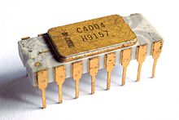
Computer History
Electronic Computers
3rd generation
integrated circuits (1965-1974)
Intel 4004 (1971)
The first commercially available microprocessor
10 µm process
92,000 instructions per second
1 MHz clock rate
Microprocessors and Assembly Language, Fall 2019, AUT, Tehran, Iran

Slide 13
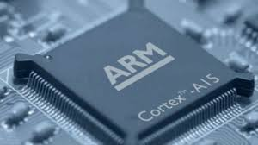
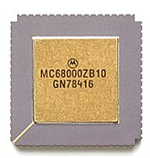
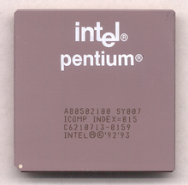
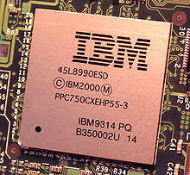
Computer History
Electronic Computers
4th generation: VLSI
1974-1989
5th generation: ULSI
1990-present
Microprocessors and Assembly Language, Fall 2019, AUT, Tehran, Iran

Slide 14
Computer History
Year | Technology Used in Computers | Relative Performance per unit cost
~1950 | Vacuum tube | 1
1960s | Transistor | 35
1975 | Integrated circuit | 900
1995 | Very large scale integrated circuit | 2,400,000
2005 | Ultra large scale integrated circuit | 6,200,000,000
Microprocessors and Assembly Language, Fall 2019, AUT, Tehran, Iran

Slide 15
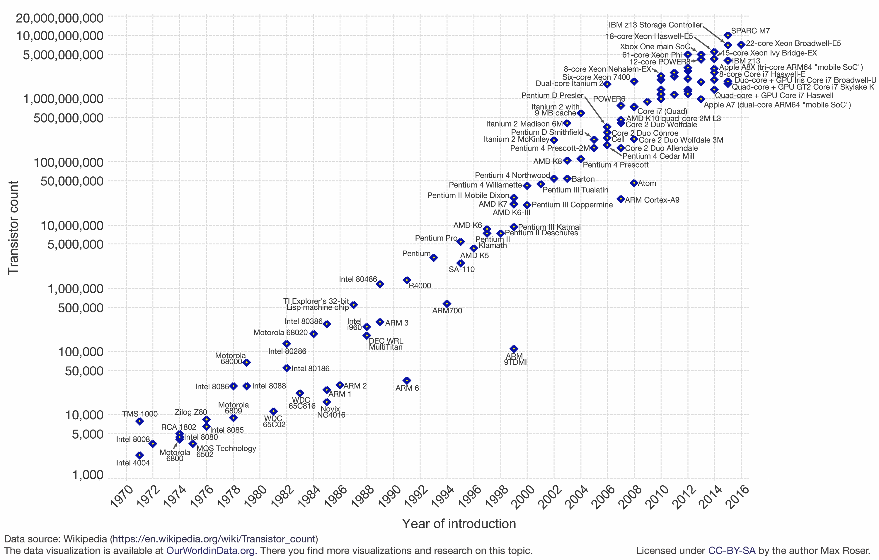
Computer History
What happened from 1970?
Transistor count doubles every 24-month
Microprocessors and Assembly Language, Fall 2019, AUT, Tehran, Iran

Slide 16
Instruction Set Architecture (ISA)
A set of instructions used by a machine to run programs
Interface between hardware & software
Computer language vocabulary
Provides an abstraction of hardware implementation
Hardware implementation decides what and how instructions are implemented
ISA specifies
Instructions, Registers, Memory access, Input/output
Applications
Compilers
Operating System
Architecture (ISA)
Microarchitecture
Digital Design
Circuit
Device
Microprocessors and Assembly Language, Fall 2019, AUT, Tehran, Iran

Slide 17
Instruction Set Architecture (ISA)
How many instructions needed?
What functionalities required?
Load/store
Control
Arithmetic/logic
Microprocessors and Assembly Language, Fall 2019, AUT, Tehran, Iran

Slide 18
Instruction Set Architecture (ISA)
Key ISA decisions
Instruction length
Number, length, and types of registers
Where operands reside
How to access memory
Instruction format
Operand format
How many and how big
Microprocessors and Assembly Language, Fall 2019, AUT, Tehran, Iran

Slide 19
Instruction Set Architecture (ISA)
Instruction length
Variable:
x86 – Instructions vary from 1 to 17 Bytes long
VAX – from 1 to 54 Bytes
Fixed:
MIPS, PowerPC, ARM:
all instruction are 4 Bytes long
Microprocessors and Assembly Language, Fall 2019, AUT, Tehran, Iran

Slide 20
ISA: Instruction length
Variable-length instructions
Require multi-step fetch and decode
Allow for a more flexible and compact instruction set
CISC processors like x86 & VAX
Complex Instruction Set Computing
Fixed-length instructions
Allow easy fetch and decode
Simplify pipelining and parallelism
RISC processors like MIPS & PowerPC
Reduced Instruction Set Computing
Microprocessors and Assembly Language, Fall 2019, AUT, Tehran, Iran

Slide 21
ISA: RISC vs. CISC
Early Trend
Adding more instructions to next generation CPUs to do more complicated operations
VAX arch had an instruction to multiply polynomials!
CISC Philosophy
Limited main memory + immature compilers
More dense instructions, highly encoded, variable length instructions
Data loading as well as calculation
Microprocessors and Assembly Language, Fall 2019, AUT, Tehran, Iran

Slide 22
ISA: RISC vs. CISC
RISC Philosophy
Keep ISA small and simple
Makes it easier to build faster hardware
Let SW do complicated operations by composing simpler instructions
Note on “Reduced" in RISC Phrase
Amount of work any single instruction accomplishes reduced
Single ALU operation, single memory access, …
Microprocessors and Assembly Language, Fall 2019, AUT, Tehran, Iran

Slide 23
ISA: RISC vs. CISC
CISC Problems
Performance tuning challenging
Complex/high-level instructions rarely used
Slower clock rates
Longer time-to-market
Due to prolonged design time
CISC Features
Ease compiler implementation
HW supports all kind of addressing modes
Microprocessors and Assembly Language, Fall 2019, AUT, Tehran, Iran

Slide 24
ISA: RISC vs. CISC
RISC Features
Low complexity
Less error-prone HW implementation
Implementation advantages
Less transistors
Extra space: more registers, cache
Marketing
Reduced design time
Microprocessors and Assembly Language, Fall 2019, AUT, Tehran, Iran

Slide 25
ISA: How Many Registers?
Advantages of a small number of registers
Requires fewer bits to specify which one
Less hardware
Faster access
Shorter wires
Faster index decoding (fewer logic levels)
Faster context switch (your OS course!)
When all registers need saving
Microprocessors and Assembly Language, Fall 2019, AUT, Tehran, Iran

Slide 26
ISA: How Many Registers?
Advantages of a larger number of registers
Fewer loads and stores needed
Less data transfer between CPU & memory
Easier to do several operations at once
Microprocessors and Assembly Language, Fall 2019, AUT, Tehran, Iran

Slide 27
ISA: Where Operands Reside?
Stack Machine
Accumulator Machine
Register-Memory Machine
Load-Store Machine
aka Register-Register Machine
Microprocessors and Assembly Language, Fall 2019, AUT, Tehran, Iran

Slide 28
ISA: Where Operands Reside?
Code sequence for C = A + B
Stack
Accumulator
Register-Memory
Load-Store
Push A
Load A
Add C, A, B
Load R1,A
Push B
Add B
Load R2,B
Add
Store C
Add R3,R1,R2
Pop C
Store C,R3
Microprocessors and Assembly Language, Fall 2019, AUT, Tehran, Iran

Slide 29
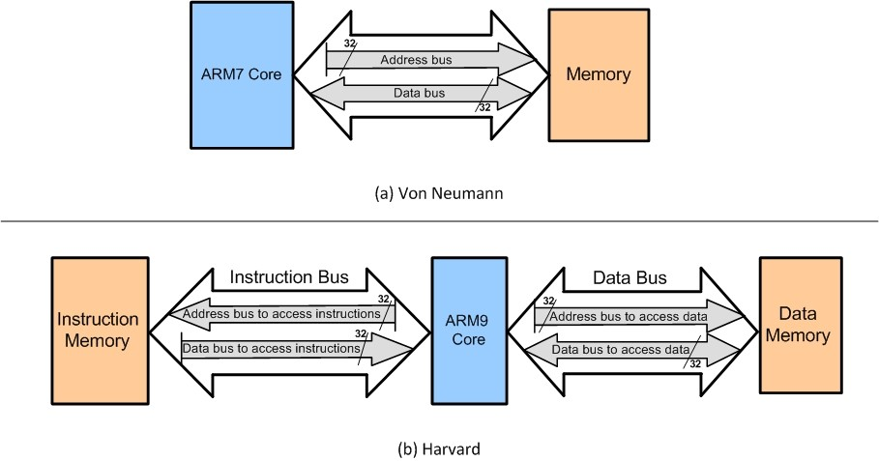
Harvard vs. Von Neumann Arch.
Microprocessors and Assembly Language, Fall 2019, AUT, Tehran, Iran

Slide 30
Types of Computer Systems
Desktops
General purpose
Market dominated by x86 processors
Various software
For use by individuals
Servers and Warehouse-Scale Computers (WSCs)
Thousands of cores and disks
Market dominated by x86-compatible server chips
Dedicated apps, plus cloud hosting of virtual machines
Increasing use of GPUs, FPGAs, and custom hardware to accelerate workloads
Microprocessors and Assembly Language, Fall 2019, AUT, Tehran, Iran

Slide 31
Types of Computer Systems
Mobile (smartphone/tablet)
>1 billion sold/year
Market dominated by ARM-ISA-compatible general-purpose processor in system-on-a-chip (SoC)
Plus sea of custom accelerators (radio, image, video, graphics, audio, motion, location, security, etc.)
Anything Else?
Microprocessors and Assembly Language, Fall 2019, AUT, Tehran, Iran

Slide 32
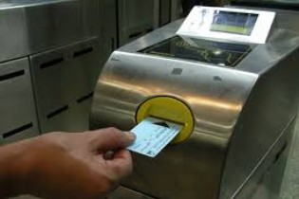
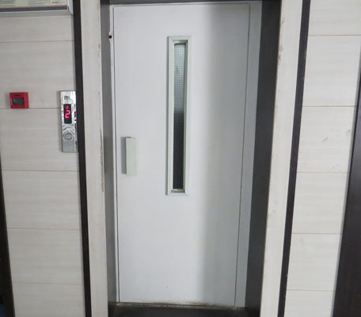
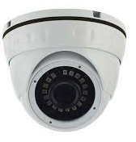
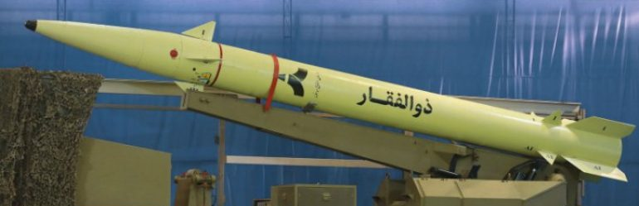

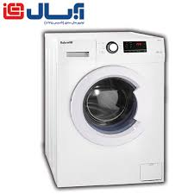
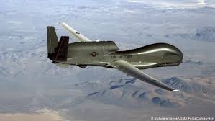
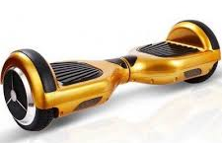
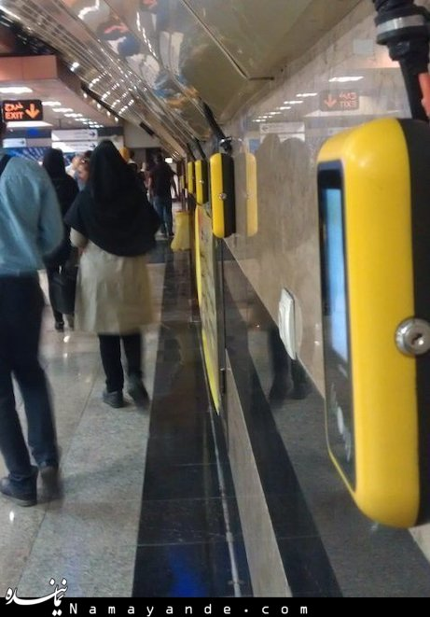
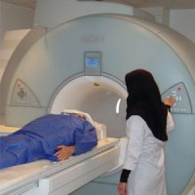
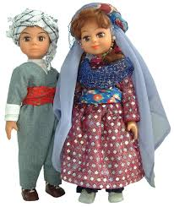
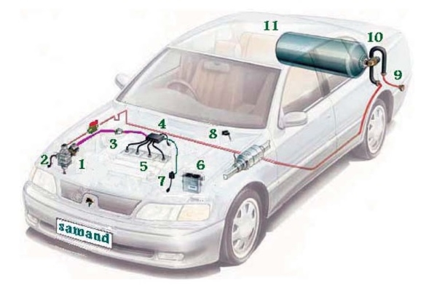
Types of Computer Systems
Embedded systems
Microprocessors and Assembly Language, Fall 2019, AUT, Tehran, Iran

Slide 33
Design Criteria
Performance
Power consumption
Energy consumption
Area
Weight
Design cost
Implementation cost
Time to market
Maintainability
Debugging
Flexibility
Scalability
…
Microprocessors and Assembly Language, Fall 2019, AUT, Tehran, Iran

Slide 34
Options for Building Embedded Systems
Dedicated hardware
ASIC (Application-specific integrated circuit)
Programmable logic (FPGA, PLD)
Software running on generic hardware
Microprocessor + memory + peripherals
Microcontroller (internal memory & peripherals)
A combination of all options (Complex systems)
Microprocessors and Assembly Language, Fall 2019, AUT, Tehran, Iran

Slide 35
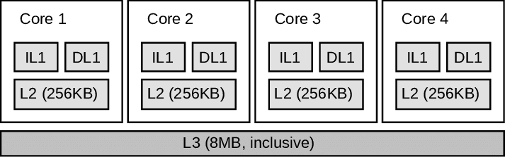
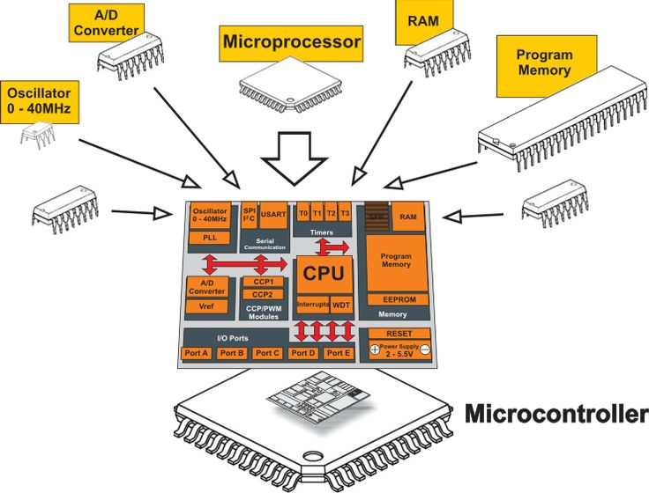
Microprocessor vs. Microcontroller
Microprocessor
An IC that has only CPUs inside it
No RAM, ROM, or other peripheral
Microcontroller (MCU)
Microprocessors and Assembly Language, Fall 2019, AUT, Tehran, Iran

Slide 36
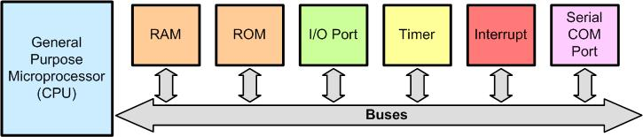
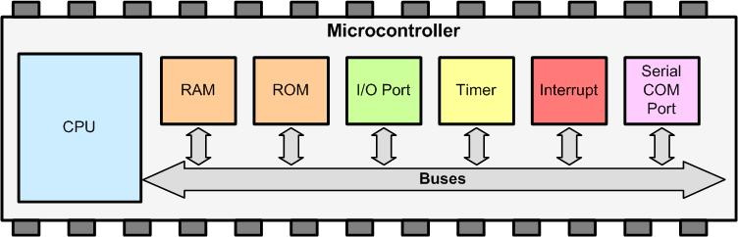
Microprocessor vs. Microcontroller
Microprocessor
Microcontroller (MCU)
Microprocessors and Assembly Language, Fall 2019, AUT, Tehran, Iran

Slide 37
Microprocessor vs. Microcontroller
Microprocessor | Microcontroller
Heart of computer systems | Heart of embedded systems
It is just a processor. Memory and I/O components are connected externally | Has processor along with internal memory and I/O components
Since memory and I/O have to be connected externally, the circuit becomes larger | Since memory and I/O have to be connected externally, the circuit is small
Cannot be used in compact system | It is efficient for compact systems
The entire energy consumption is high due to external components | Suitable for battery-operated systems
Slow memory access | Fast memory access
Is based on Von Neumann architecture (program and data are stored in the same memory module) | Is based on Harvard architecture (program and data memory are separate)
Microprocessors and Assembly Language, Fall 2019, AUT, Tehran, Iran

